Slide 1
Final Project Data Analysis
Kozhan Nurassyl
Assentay Makhmud
Abish Magzhan

Slide 2
TABLE OF CONTENTS
Data Analytics
01
02
03
Data overview
Linear Regression
KNN and SVM
A little about collecting and visualize the data statistics
Drawing linear regression line and make a prediction
Comparing two algorithms and make a classification

Slide 3
DATA OVERVIEW
01
A little about collecting and visualize the data statistics

Slide 4

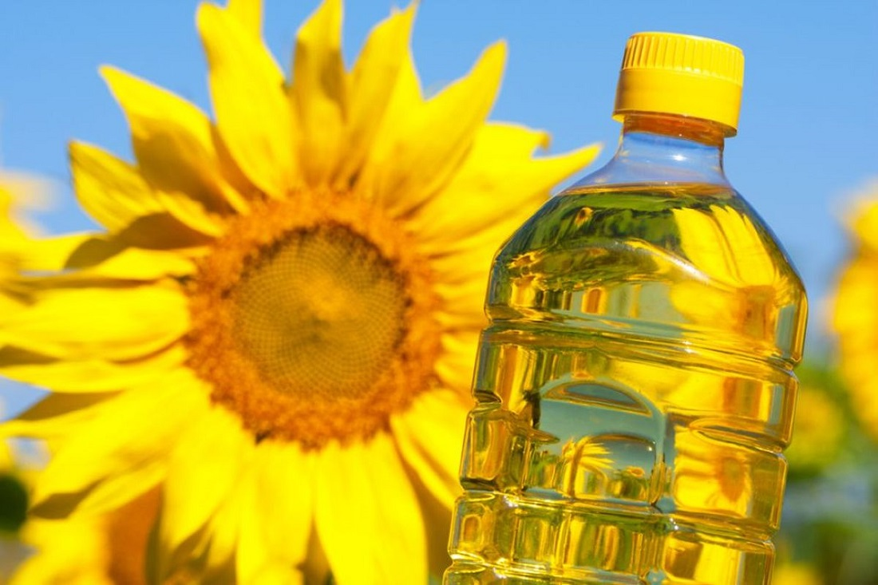
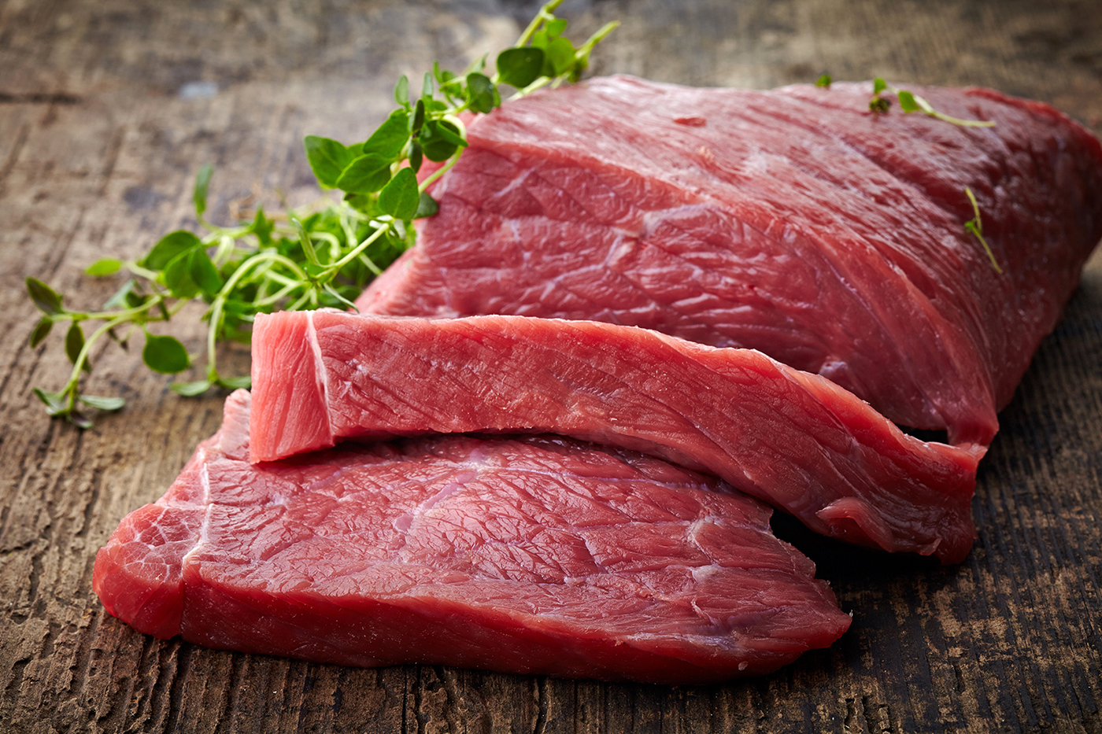
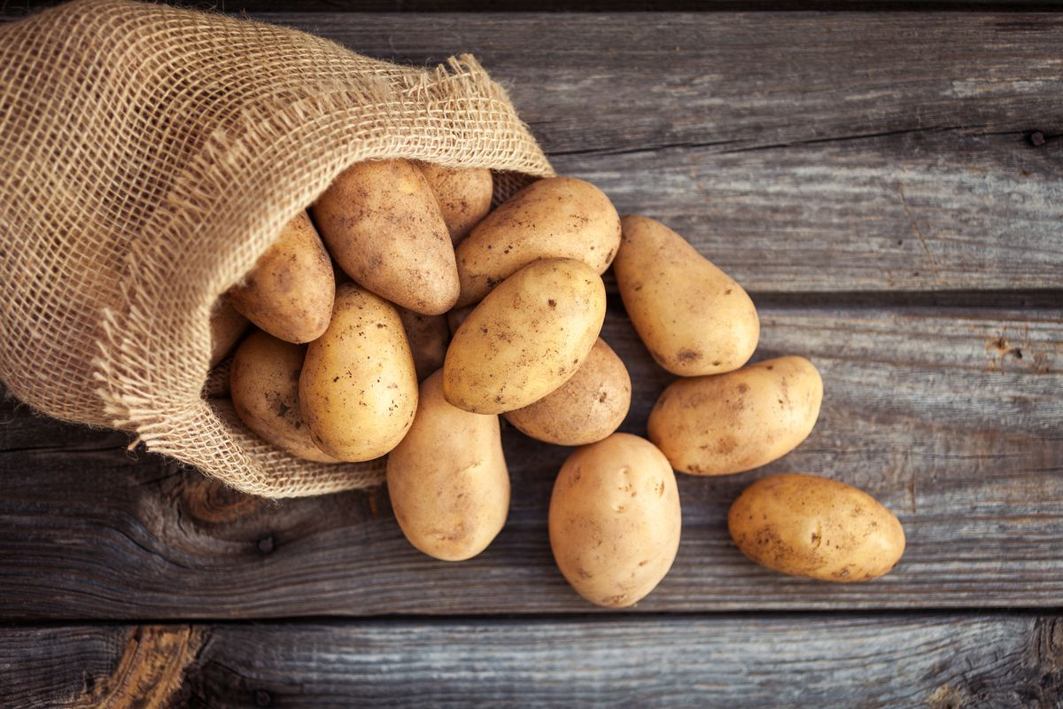
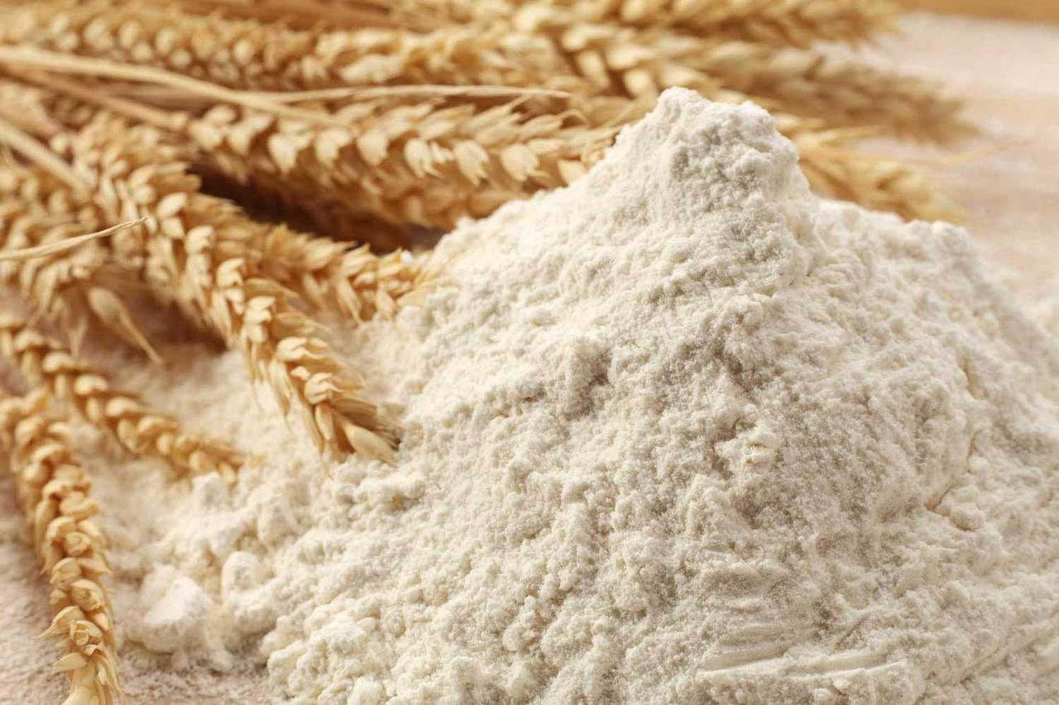
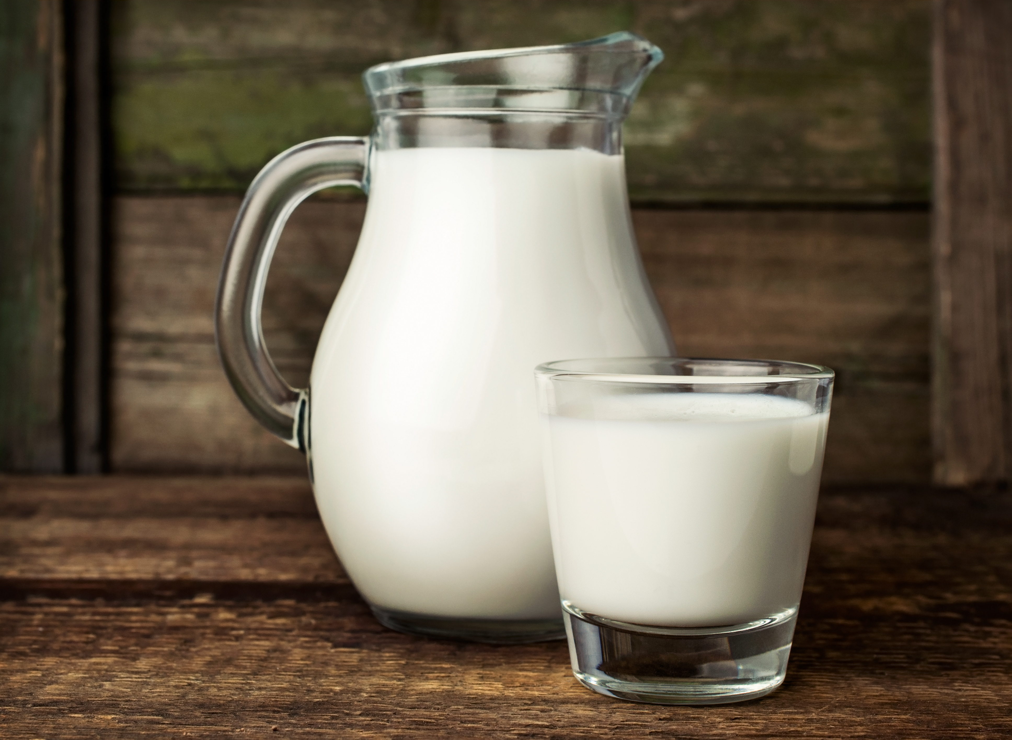
Astana
Almaty
Kostanay
Aktau
We read the data and grouped it by different regions of Kazakhstan: Astana, Almaty, Kostanay and Aktau. This will allow us to see if there are trends in food items from 2005 to 2020.

Slide 5
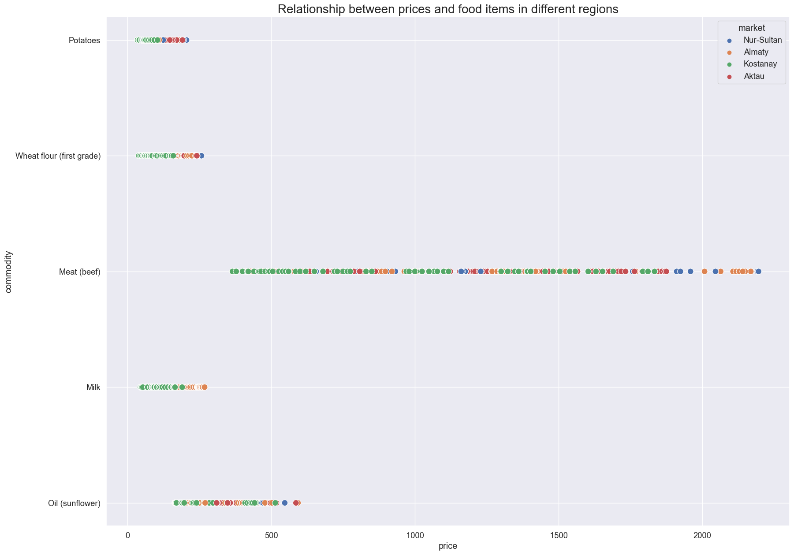
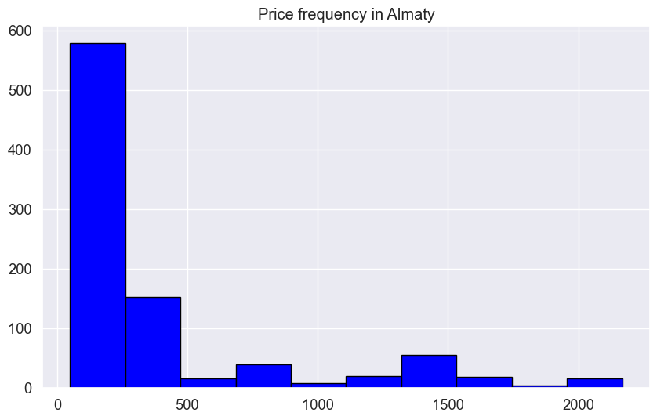
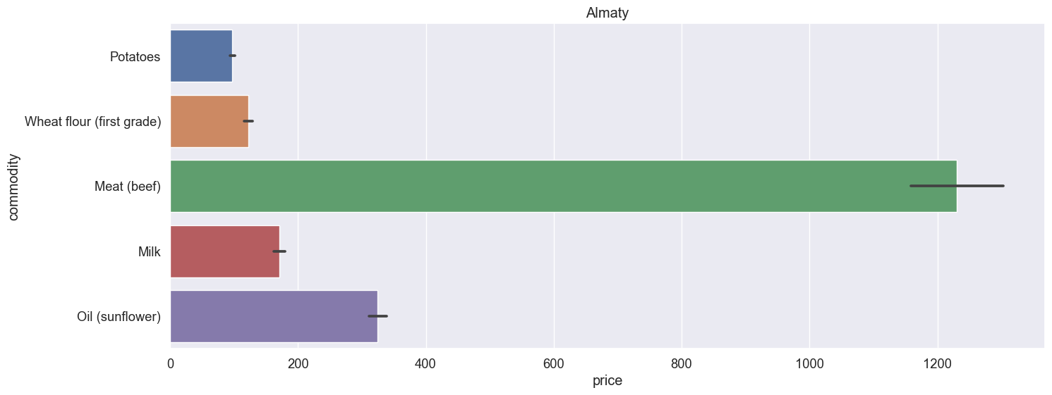
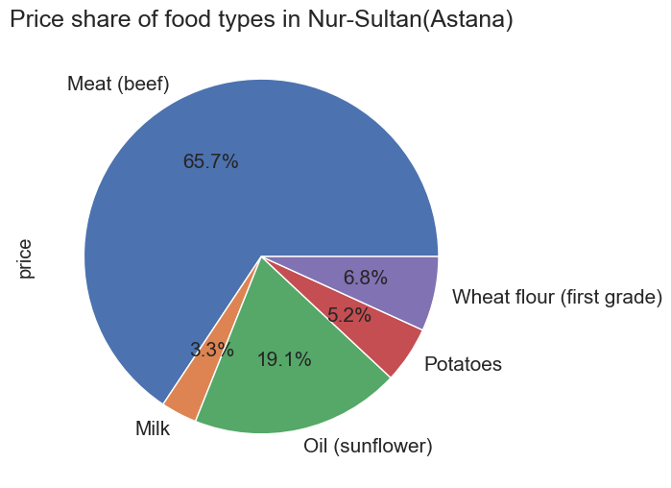
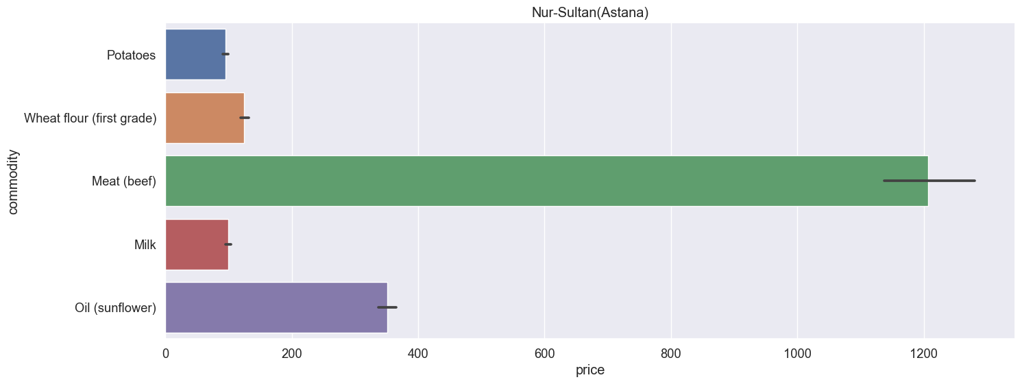
Data visualization provides a good, organized pictorial representation of the data which makes it easier to understand, observe, analyze. In this project, we will show visualization of our data using Matplotlib, Seaborn libraries.
Histogram
Scatterplot
Barplot
Pie chart

Slide 6
LINEAR REGRESSION
02
Drawing linear regression line and make a prediction

Slide 7

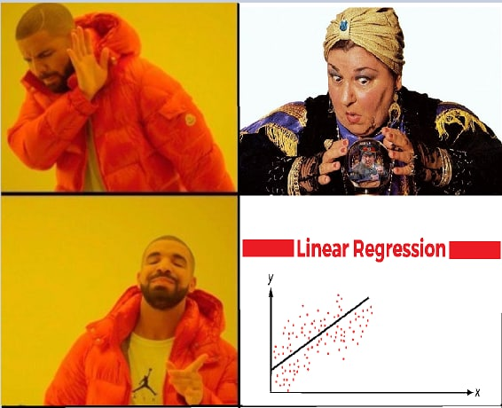
Linear regression models are a statistical procedure that helps predict the future.

Slide 8
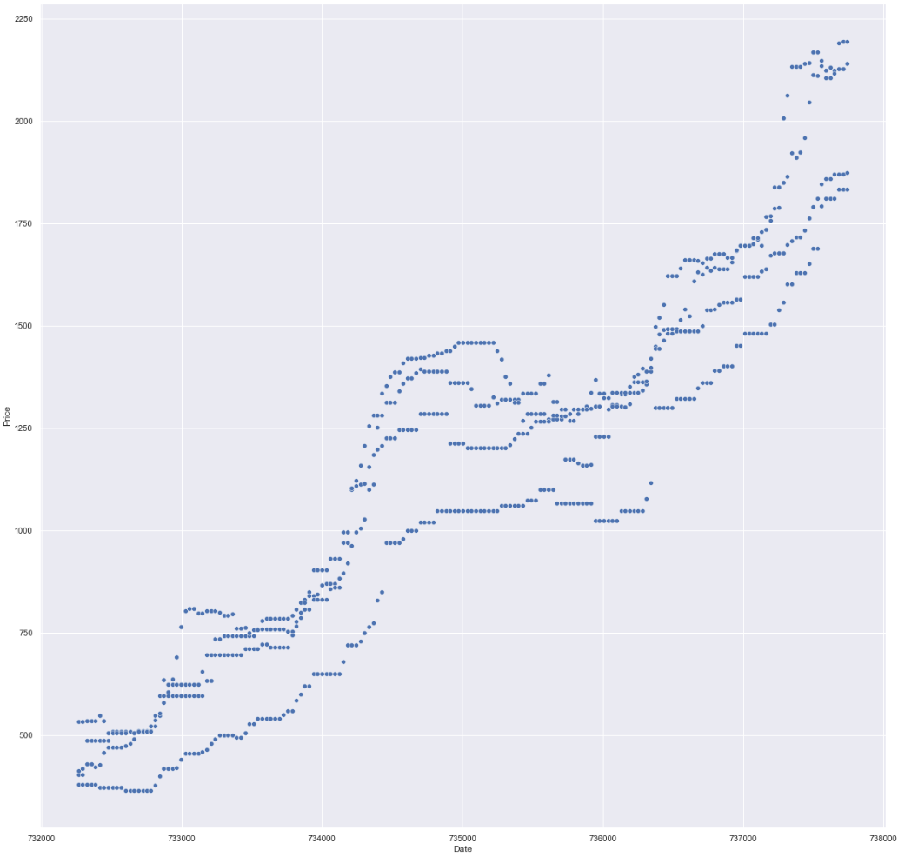

MISSION STATEMENT
To make the most accurate prediction using linear regression

Slide 9
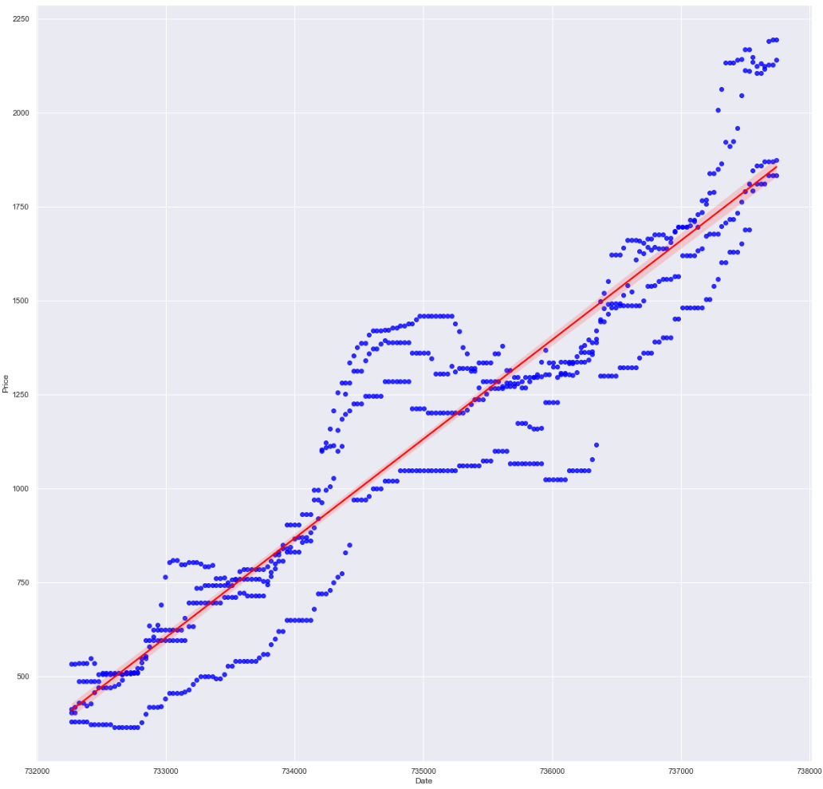
PREPARING THE TABLE
Ready method regplot can figure out the best option of regression lines
Converting data
Date and price are converted to successfully derive the regression line

Slide 10

PREDICTED GROWTH
y = kx + b
738474 * 0.26403365 + (-192933.51545354436) = 2048.471
mean_absolute_percentage_error
coef_ = 0.26403365
As we found out (~11%) at this point the price of beef should be in the range [1853-2311] tenge
intercept_ =
-192933.51545354436
737744 = 2020-11-15

Slide 11
KNN and SVM
03
Classify data, make comparison

Slide 12
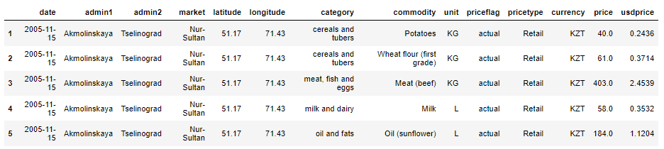
Preparation stage

Slide 13
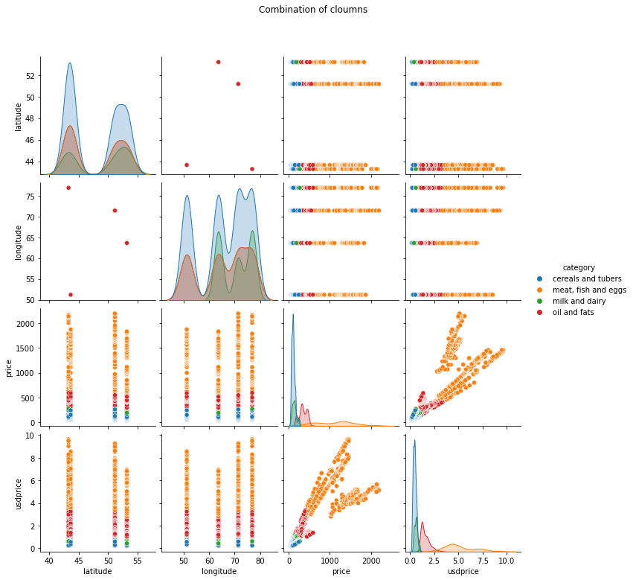

Slide 14
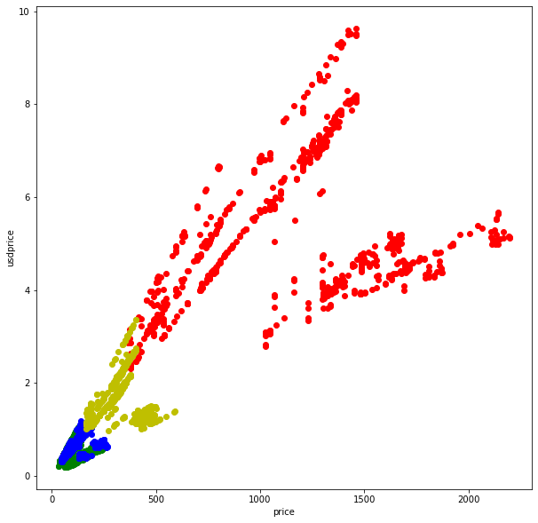
Category
Red: meat, fish and egg
Green: cereals and tubers
Blue: milk and dairy
Yellow: oil and fats

Slide 15
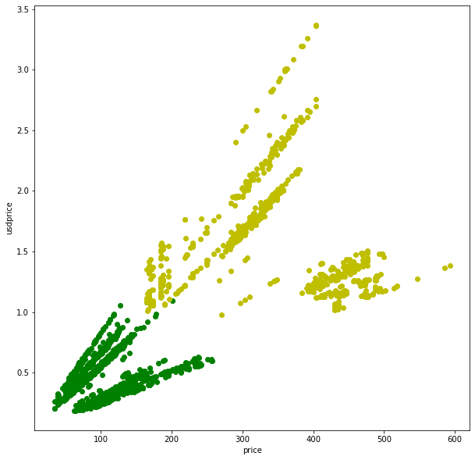
Final chosen data
Category
Green: cereals and tubers
Yellow: oil and fats

Slide 16
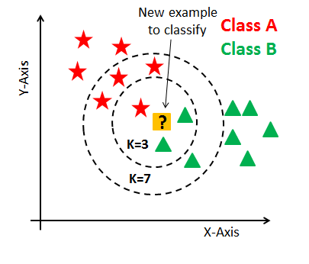
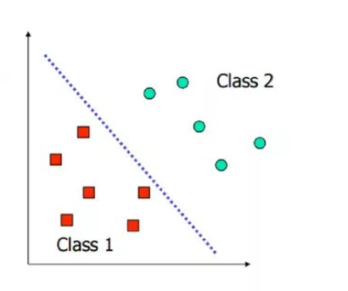
KNN
SVM

Slide 17
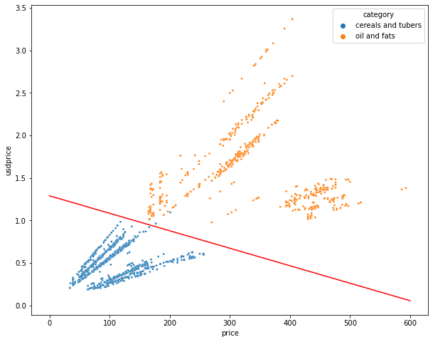
Accuracy
97%
67%
KNN
SVM

Slide 18
Thanks!

